Slide 1
Balocco demo plan

Slide 2
Use cases to be shown
Full speed lane centering
Driver assisted lane change
Overtake
Nudge
Roadworks handling

Slide 3
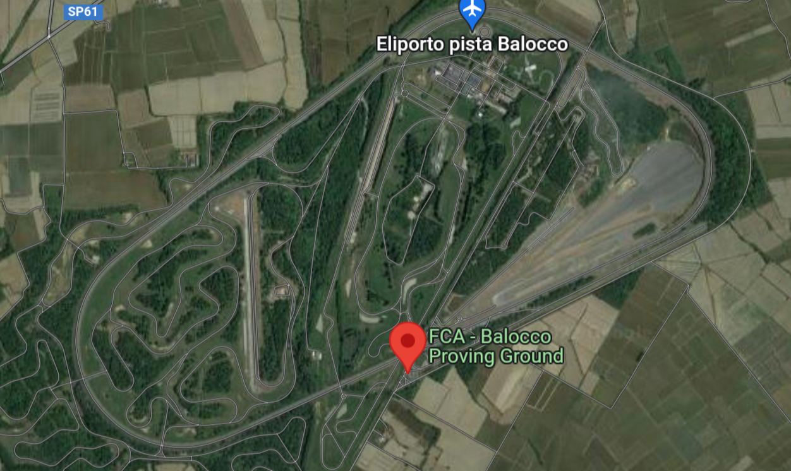
Balocco demo loop 1 (90 kph)
Need 1 additional vehicle
Set min_acc_speed to 90 kph in iveco-3.yml
Drive on right lane in CW direction
Overtake slow vehicle moving at 40 kph ( see figure on left )
Driver assisted lane change to left ( see figure on left )
Driver assisted lane change to right ( see figure on left )
Maneuver 1: Overtake slow vehicle moving at 40 kph
Maneuver 2. Driver assisted lane change to left
Maneuver 3. Driver assisted lane change to right

Slide 4
Balocco demo loop 2 (80 kph)
Need 1 additional vehicle
Set min_acc_speed to 80 kph in iveco-3.yml
Drive on right lane in CW direction
Nudge for vehicle on shoulder
Stop for lanes blocking road
Maneuver 1: Nudge for vehicle on shoulder
Maneuver 2. Stop for lanes blocking road

